Slide 1
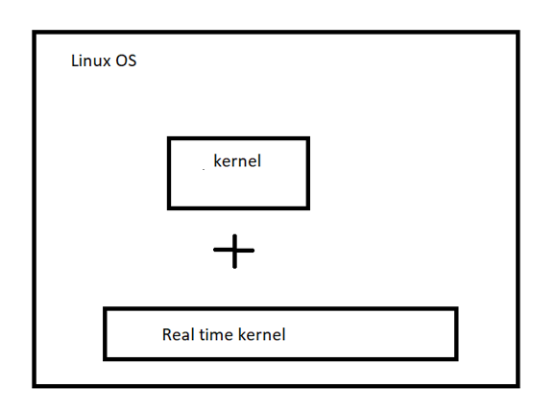
Linux internal architecture
Real time linux
`
Process – 1. Independent
2. co-operating process
a. inter process communication

Slide 2
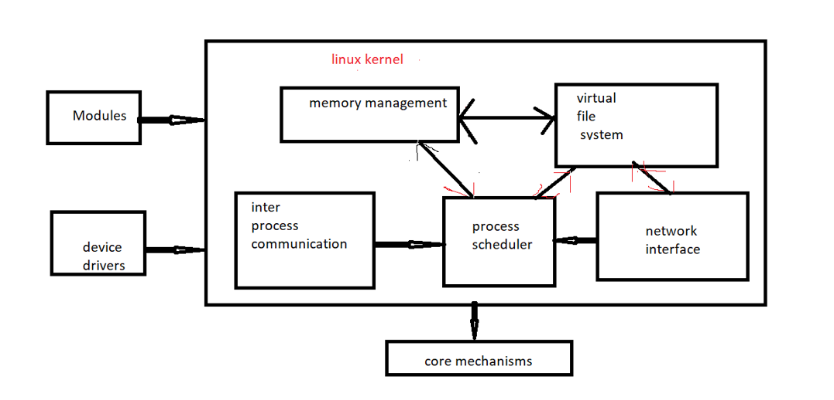
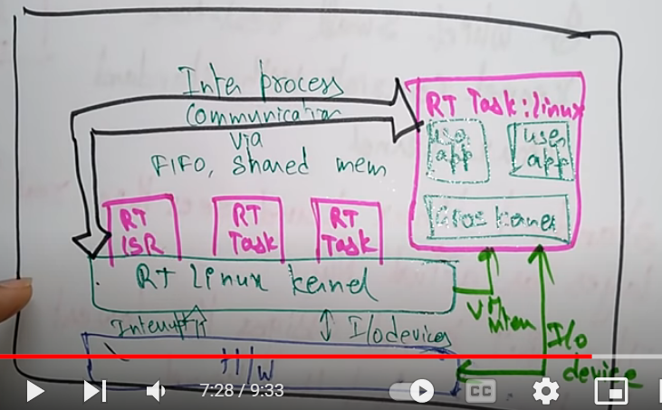
Linux internal architecture
Linux internal architecture:

Slide 3
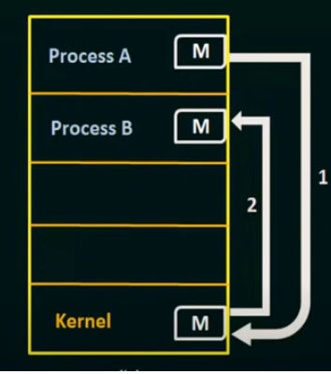
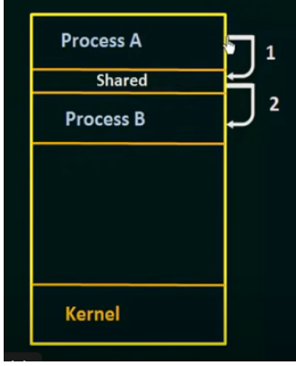
Models of inter process communication
Fundamental communication models of inter process communication are :
Message passing 2. Shared memory

Slide 4
IPC Mechanisms/Functions/Methods
Message queue
Shared memory
Semaphore
mailbox
Signals
Socket
Pipe
Remote procedure call

Slide 5
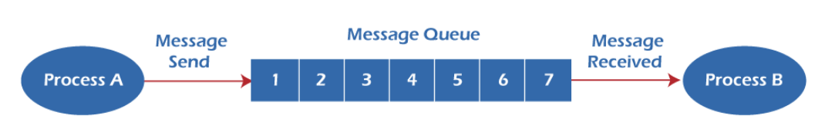
Message queue
Message queue is an unbounded FIFO queue used in non-shared memory.
Functions of message queue:
msgget() - int msgget (key_t key, int msgflg);
msgsnd() - int msgsnd (int msqid, const void *msg_ptr, size_t msg_sz, int msgflg);
msgrcv() - int msgrcv (int msqid, void *msg_ptr, size_t msg_sz, long int msgtype, int msgflg);
msgctl() - int msgctl (int msqid, int command, struct msqid_ds *buf);

Slide 6
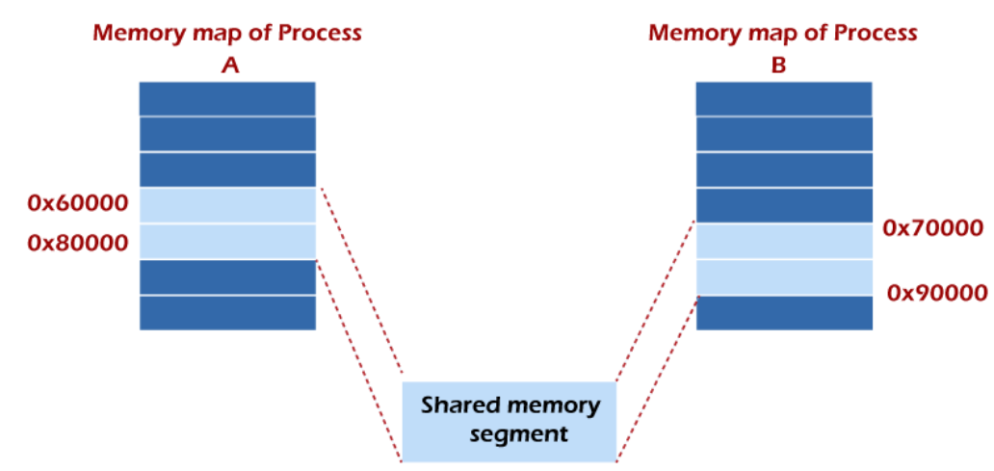
Shared memory
Functions of shared memory:
shmget() - int shmget (key_t key, size_t size, int shmflg);
shmat() - void *shmat(int shmid, const void *shmaddr, int shmflg);
shmdt() - detached using shmdt()

Slide 7
Semaphore
Types of semaphore : 1. general semaphore 2. binary semaphore
Program to understand semaphore :
1.General semaphore 2.binary semaphore
Wait(s) do
{ {
while (s<=0) // no operation wait(s); //critical section
s:s-1; signal(s); //remainder section
} }while(true);
Signal(s) : s = s+1;
Functions of semaphore:
semget() – int semget(key_t key,int nsems,int semflg);
semop() - int semop(int semid,struct sembuf *semops,size_t nsemops);
semctl() – int semctl(int semid,int semnum,int cmd);

Slide 8
Mailbox
Functions of mailbox:
1.new( ) : func new(int bound = 0)
2.num( ) : func int num();
3.get( ) : func task get(ref_singular_message)
4.try_get( ) : func int try_ get(ref_singular_message)
5.peek( ) : func task peek(ref_singular_message)
6.try_peek( ) : func int try_ peek(ref_singular_message)
7.put( ) : func task put(ref_singular_message)
8.try_put( ) : : func int try_ put(ref_singular_message)

Slide 9
Signals
Kill –l (listing signal names)
The actions performed for the signals are as follows −
1.Default Action
2.Handle the signal – handling the signal using two system calls are : 1. signal()
2.sigaction()
3.Ignore the signal

Slide 10
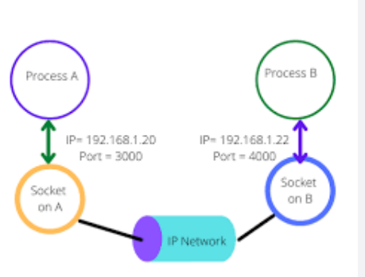
Socket communication
A socket is identified by an IP address concatenated with a port number.

Slide 11
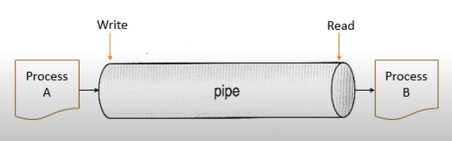

Pipe
Implementation of Pipe :
Uni directional pipes
Bi directional pipes
Types of pipes:
1.ordinary pipes
2.Named pipes

Slide 12
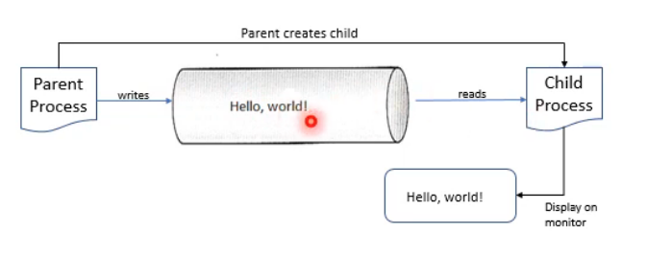
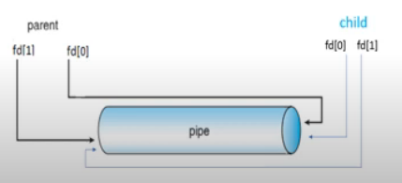
Pipe
c program for pipe:

Slide 13
#include<sys/types.h>
#include<stdio.h>
#include<string.h>
#include<unistd.h>
#define BUFFER_SIZE 25
#define READ_END 0
#define WRITE_END 1
int main(void)
{
char write_msg[BUFFER_SIZE] = "Hello World";
char read_msg[BUFFER_SIZE];
int fd[2];
int pid;
if(pipe(fd) == -1) //create the pipe
{
fprintf(stderr,"pipe failed");
return 1;
}
pid = fork(); //fork a child process
if(pid<0) //error occured
{
fprintf(stderr,"fork failed");
return 1;
}
if(pid>0)
{ //parent process
close(fd[READ_END]);//close the unused end of the pipe
write(fd[WRITE_END],write_msg,strlen(write_msg)+1); //write to the pipe
close(fd[WRITE_END]); //Close the write end of pipe
}
else
{ // child process
close(fd[WRITE_END]); //close the unused end of the pipe
read(fd[READ_END],read_msg,BUFFER_SIZE); //Read from the pipe
close(fd[READ_END]); //Close the read end of the pipe
}
return 0;
}

Slide 14
Remote procedure call
Client-server interaction via request-response message passing system.
Call back RPC
Broad cast RPC
Batch mode RPC

